Slide 1
Supermarket products: A comparison
between Carrefour, Esselunga and Conad

Slide 2
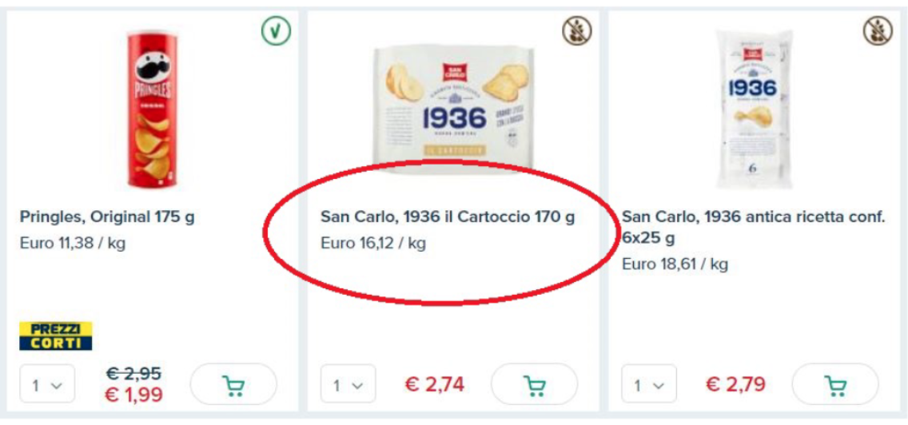
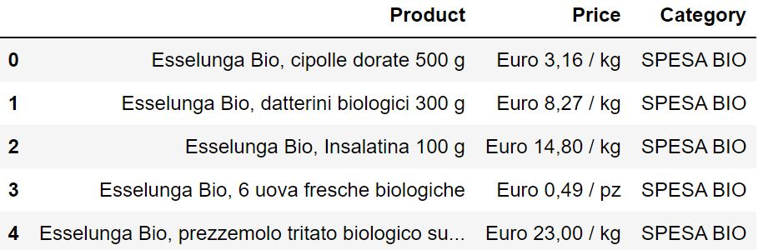
Main objective
Our main goal was to compare prices of the same products across 3 supermarkets in Milan: Esselunga, Conad and Carrefour.
The technique we employed to carry out this task is web scraping.
For each supermarket, we obtained all product names, their prices and the categories they belong to.

Slide 3
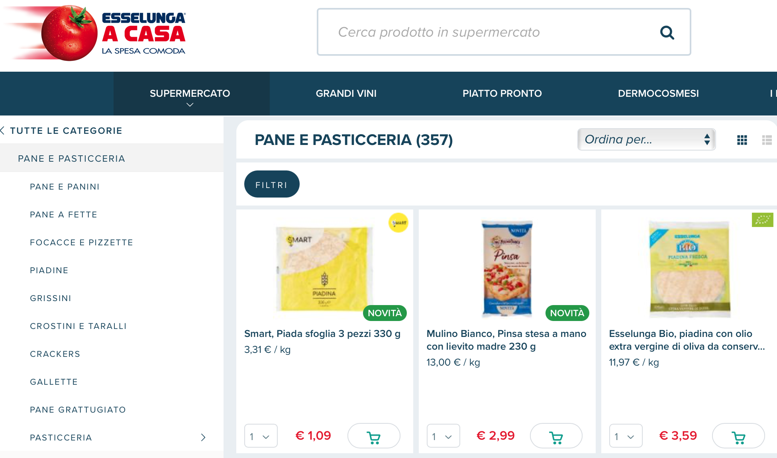
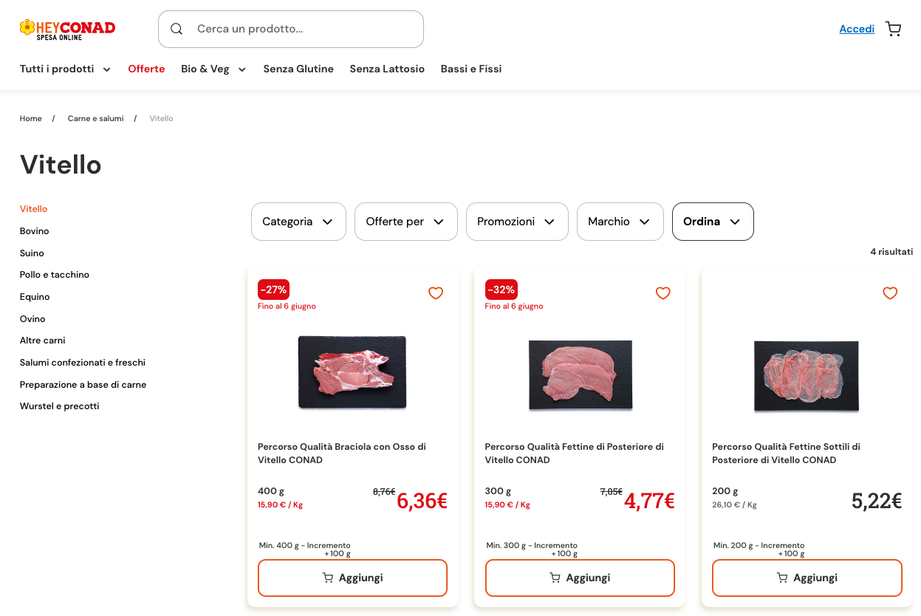
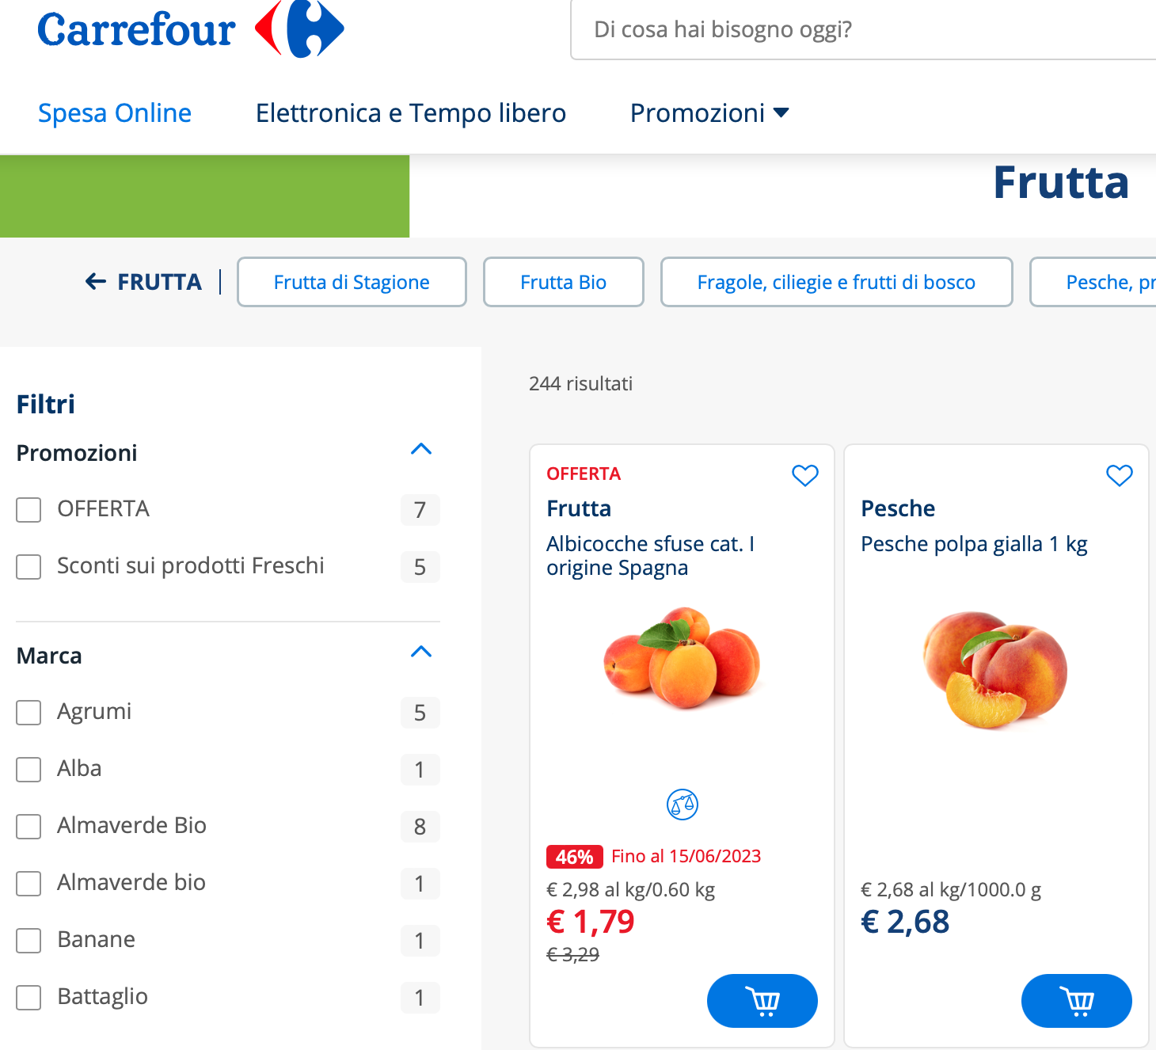
From….

Slide 4
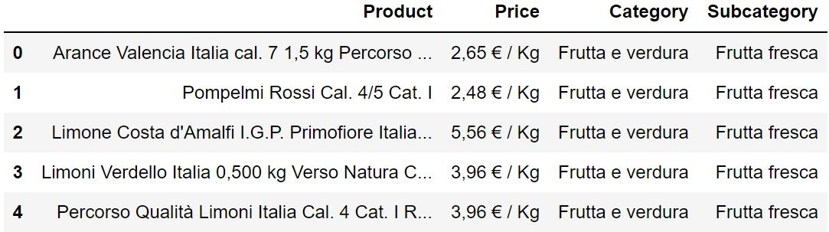
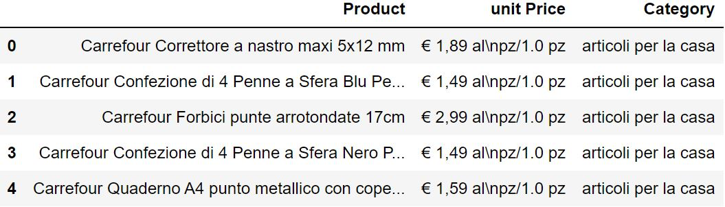
…to

Slide 5
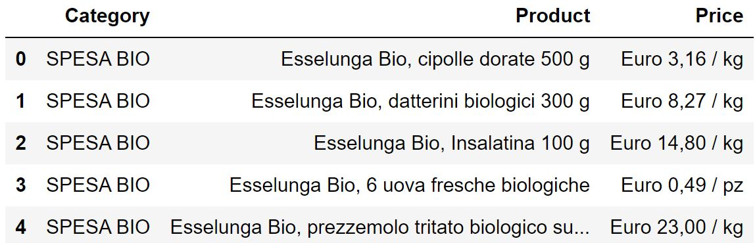
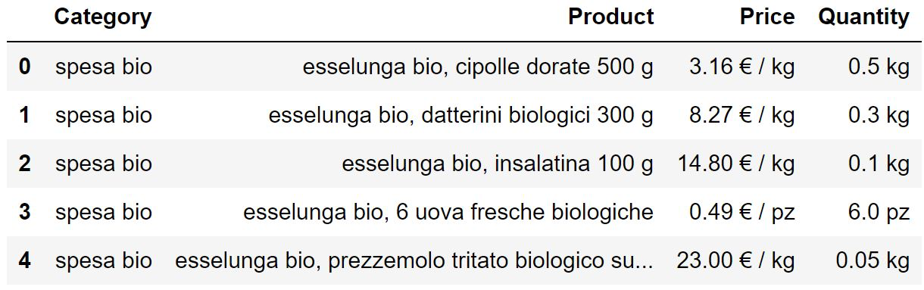
DATA PREPROCESSING
We standardised the prices across the three supermarkets
extracted quantities when present

Slide 6
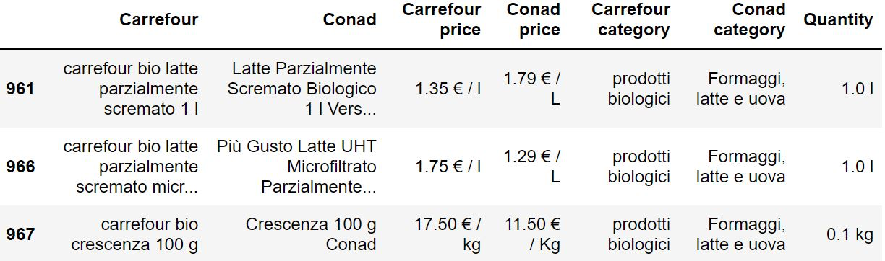
DATA INTEGRATION from three different sources
Firstly we performed pairwise comparisons. For each supermarket, we looked for matching products from one other supermarket, provided that the products shared the same weight
In order for there to be a match, we imposed the condition that two product strings had to have a cosine similarity of at least 70%
We created a Category column, where we saved the category names of the identified products
We decided to keep products even in the case they presented no matches

Slide 7
CA
CO
ES
CA
CO
ES
A
B
C
D
E
F
G

Slide 8
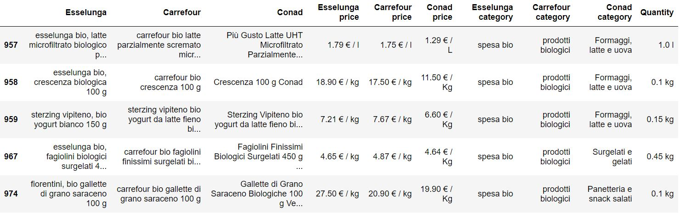
DATA INTEGRATION
We merged the three datasets, obtaining a final one with all products from all supermarkets with their matches from other supermarkets, if any.
Duplicates were dropped

Slide 9
DATA QUALITY
We proceeded by checking random matches, to see if the ones we had obtained actually linked together the same products
For each supermarket, we chose a category and sampled 50 products.
87% of the matches showed real correspondences of data
Most discrepancies were due to flavour differences:
eg. milk, pro 35g high protein cacao 350 g,
milk pro high protein 35g vaniglia 350 g,
milk pro high protein 35g vaniglia 350 g

Slide 10
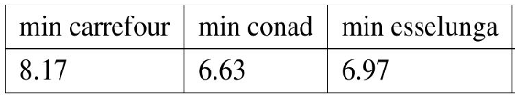
QUERIES
We exported the integrated dataset into SQL and made some queries.
Find the most convenient store to buy Noberasco dried fruit
Suppose that you need apples, pears and bananas. Where best to buy them to spend less?

Slide 11
THANK YOU FOR YOUR ATTENTION

